Slide 1



$$\vec{v}$$
$$B_{2}$$
$$B_{1}$$

Slide 2


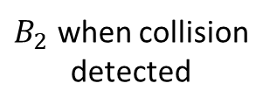
$$\vec{v}$$
$B_{2}$ when collision
detected
$$B_{1}$$
$$d$$
$B_{2}$ at TOI

Slide 3



$$\vec{v}$$
$B_{2}$ when collision
detected
$$\vec{c}$$
$$B_{1}$$
$$θ$$
$$d$$
$B_{2}$ at TOI
$$δ$$

